Slide 1
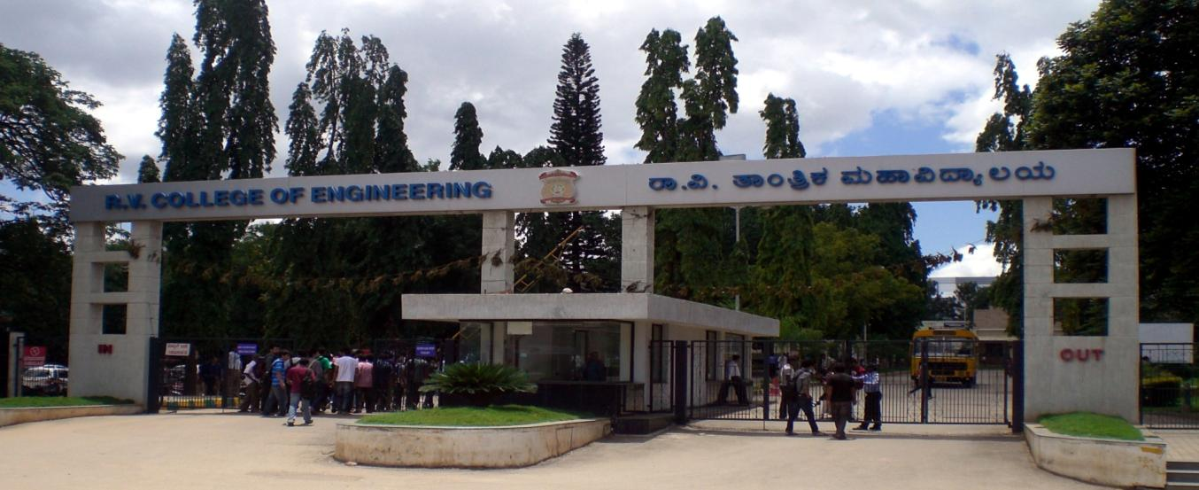
VIII Semester Major Project Work (12CS81)
Department of Computer Science,
R V College of Engineering, Bengaluru.

Slide 2
CCTV Video Summarization in Urban Environments
A.S. Karthik 1RV15CS001
Abhishek Krishna 1RV15CS007
Gagan Deep G 1RV15CS053
Phase-4
Internal Guide : Dr Ramakanth Kumar P (Professor and HoD CSE)

Slide 3
Incorporation of suggestions
Incorporation of timestamps in summary
Understanding Poisson blending thereby improving overlay quality
Corrected flow diagrams for simulated annealing

Slide 4
Implementation Part-1 (Real-Time)
Background Masking
Object Tubes computation and extraction
Motion Detection
Object Detection and tagging
Footage and metadata storage

Slide 5
Implementation Part-2 (Query Phase)
Tube Rearrangement
Blending tubes and background to create summary
Selection of tubes based on user query
Time-lapse background generation

Slide 6
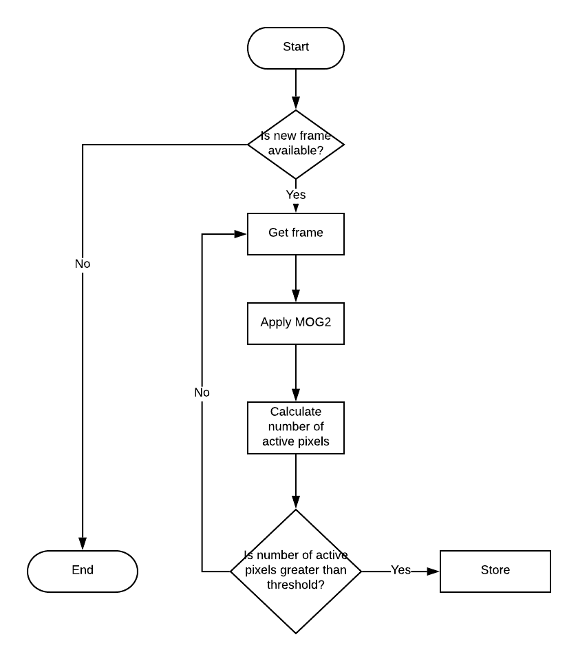
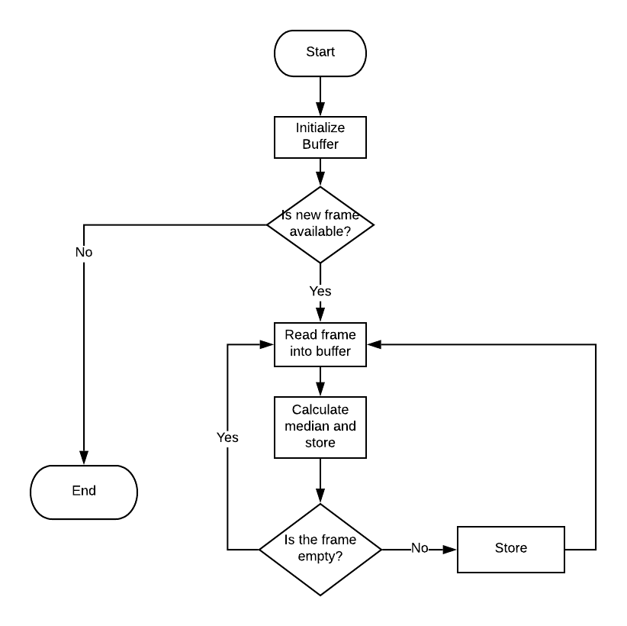
Flowcharts
Background Creation
Motion Detect

Slide 7
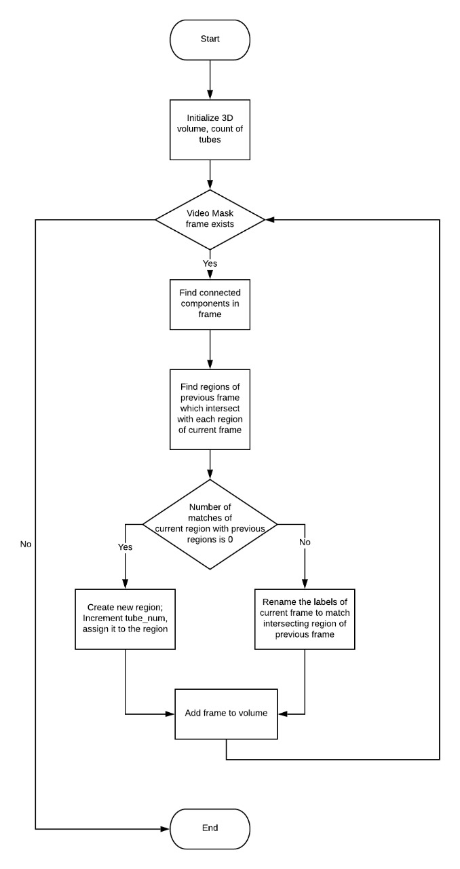
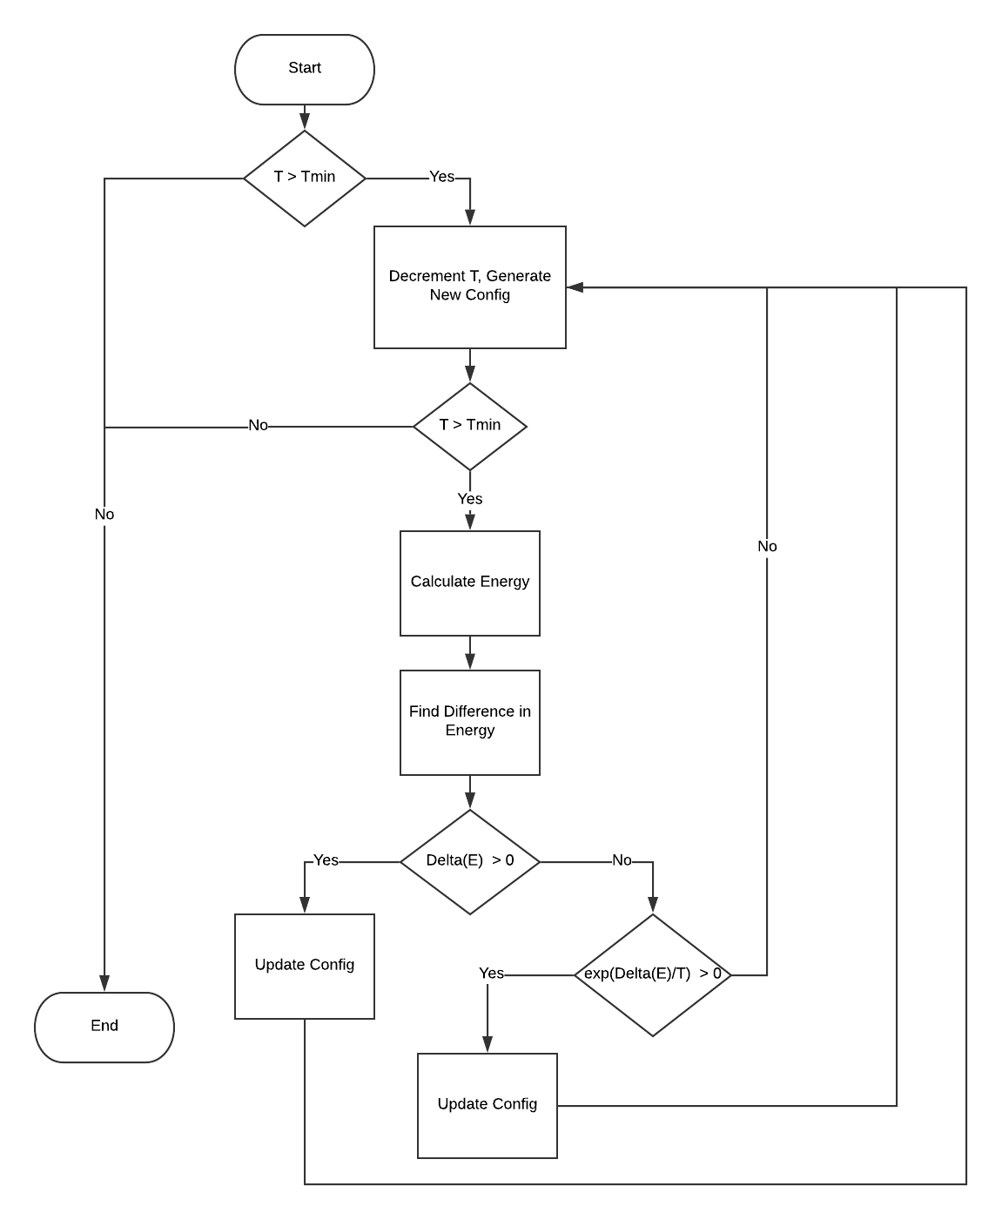
Tube Extraction
Simulated Annealing

Slide 8
Hardware and Software requirement
Hardware
Platform / CPU
Modern multi-core processor (Ex: Intel Core i7 6700HQ) on x86/ARM platform
Memory
Minimum: 8 GB
Recommended: 16 GB or higher
Storage
64GB or higher for storing an entire day of video (depends on video resolution)
Test Environment:
OS: Windows/Linux/MacOS
Tool: Python3 with OpenCV v4, Jupyter Notebook
Data: Video footage from cameras

Slide 9
Unit Testing – Read Video
Sl No. of Test Case | 1
Name of Test Case | Read video
Feature being Tested | Proper loading of video from disk
Description | -
Sample Input | Video file
Expected Output | Load list of frames into memory if file exists, else error that file is not found
Actual Output | As expected
Remarks | Test case passed successfully

Slide 10
Unit Testing – Motion Detection
Sl No. of Test Case | 2
Name of Test Case | Motion detection and masking
Feature being Tested | Detection of motion and generation of mask of movement in the frame
Description | For each frame, motion should be detected and a mask of which part of the frame has motion should be created
Sample Input | List of video frames
Expected Output | List of binary (black and white) masked frames
Actual Output | As expected
Remarks | Test case passed successfully

Slide 11
Unit Testing - BG Video
Sl No. of Test Case | 3
Name of Test Case | Background video generation
Feature being Tested | Generation of static background
Description | For a given video, a static background is to be generated from the video with movement so that events can be blended into it, to generate the summary
Sample Input | List of video frames
Expected Output | List of binary frames with minimal/ no movement
Actual Output | Static frames, with only slow/gradual changes like shadows changing
Remarks | Test case passed successfully

Slide 12
Unit Testing – Tube Labelling
Sl No. of Test Case | 4
Name of Test Case | Tube labelling
Feature being Tested | Labelling of detected motion with unique event IDs
Description | From the motion mask, the different events occurring in the same frame must be distinguished by assigning a unique even ID to each event
Sample Input | List of masked frames with pixel value of 255 representing the motion
Expected Output | List of frames with event ID in each pixel in place of 255 value
Actual Output | As expected, with colliding objects categorized as into the same event
Remarks | Test case passed successfully

Slide 13
Unit Testing – Tube extraction
Sl No. of Test Case | 5
Name of Test Case | Tube extraction
Feature being Tested | Extract every event from the labelled volume into separate tubes
Description | From the labelled volume, the different events are extracted into separate tubes with the original start time being stored
Sample Input | List of labelled frames
Expected Output | Multiple tubes, each tube a set of frames, which has the motion mask of individual events
Actual Output | As expected, with colliding objects categorized as into the same event
Remarks | Test case passed successfully

Slide 14
Unit Testing – Colour tube generation
Sl No. of Test Case | 6
Name of Test Case | Colour tube generation
Feature being Tested | Generate a colour/object tube using original video and individual tube mask
Description | Bitwise AND operation is used to extract only the required part of original video
Sample Input | List of original frames, List of individual event tubes
Expected Output | Multiple tubes, each tube a set of frames, which has the coloured image of individual events
Actual Output | As expected
Remarks | Test case passed successfully

Slide 15
Unit Testing – Object Detection
Sl No. of Test Case | 7
Name of Test Case | Object detection
Feature being Tested | Detection of objects in colour tubes
Description | YOLOv3 object detector is run on few frames in each colour tube to detect the objects
Sample Input | Colour tubes
Expected Output | Set of tags associated with each tube
Actual Output | All objects detected correctly in majority of cases
Remarks | Test case passed successfully

Slide 16
Unit Testing – Simulated Annealing
Sl No. of Test Case | 8
Name of Test Case | Simulated Annealing
Feature being Tested | Optimize the placement of tubes
Description | The selected colour tubes are to be placed optimally to prevent overlap of events
Sample Input | Colour tubes with their lengths, with start time set to 0
Expected Output | Tubes with optimal start times
Actual Output | Optimization works well and avoids collision of events in most cases
Remarks | Test case passed successfully; Further testing required for longer videos and videos with more events

Slide 17
Unit Testing – Image Blending
Sl No. of Test Case | 9
Name of Test Case | Image blending
Feature being Tested | Blending of tubes into the static background
Description | The selected colour tubes are to be blended into the static background at the optimal time determined by simulated annealing
Sample Input | Colour tubes and metadata, static background
Expected Output | Events blended into the background seamlessly at the time determined by simulated annealing
Actual Output | Events blended in at the correct time, but not seamlessly in all cases, especially at the edges of the frame
Remarks | Test case passed, blending function to be improved

Slide 18
Integration Testing – Tubes
Sl No. of Test Case | 1
Name of Test Case | Tube labelling and extraction
Feature being Tested | Interface between main module and tube module
Description | Data is to be passed between the modules using a defined data structure
Sample Input | Input video frames
Expected Output | Tube data structure with extracted tube mask, and colour tubes
Actual Output | As expected
Remarks | Test case passed successfully

Slide 19
Integration Testing – Detection
Sl No. of Test Case | 2
Name of Test Case | Object detection
Feature being Tested | Interface between main module and Object detection module
Description | Object detection module should return the detected tags
Sample Input | Tube data structures
Expected Output | Tube data structures with tags of detected objects
Actual Output | As expected
Remarks | Test case passed successfully

Slide 20
System Testing – Realtime Phase
Sl No. of Test Case | 1
Name of Test Case | Phase 1
Feature being Tested | Realtime phase of summary generation
Description | From the input video, the tubes are extracted, static background is generated, objects are detected and presented to the user in anticipation of phase 2
Sample Input | Input video
Expected Output | Extracted tubes, static background and tags
Actual Output | As expected
Remarks | Test case passed successfully

Slide 21
System Testing – Query Phase
Sl No. of Test Case | 2
Name of Test Case | Phase 2
Feature being Tested | Query phase of summary generation
Description | The user query with required tags is fed in, using which the summary video is generated
Sample Input | User query
Expected Output | Summary video with selected tags
Actual Output | As expected
Remarks | Test case passed successfully

Slide 22
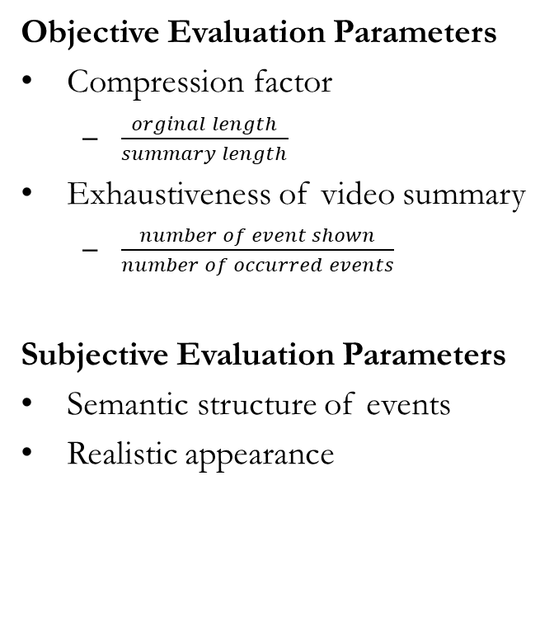
Experimental Results & Analysis
Objective Evaluation Parameters
Compression factor
$\frac{orginal length}{summary length}$
Exhaustiveness of video summary
$\frac{number of event shown}{number of occurred events}$
Subjective Evaluation Parameters
Semantic structure of events
Realistic appearance
Compression Factor
80 sec video converted to ~12 sec summary in all cases
Exhaustiveness
100% detection rate of events (people, bikes, cars)
Semantic Structure
Interacting events are shown together in all cases
Realistic Appearance
Almost realistic, blending can be improved

Slide 23
Experimental Results & Analysis
Dataset
Video clips with sparse activity, recorded in college and quiet urban environments
Performance
Realtime phase: Runs in real-time (30fps) on recommended hardware
Query phase: ~45 secs for generating a summary with 10 events

Slide 24

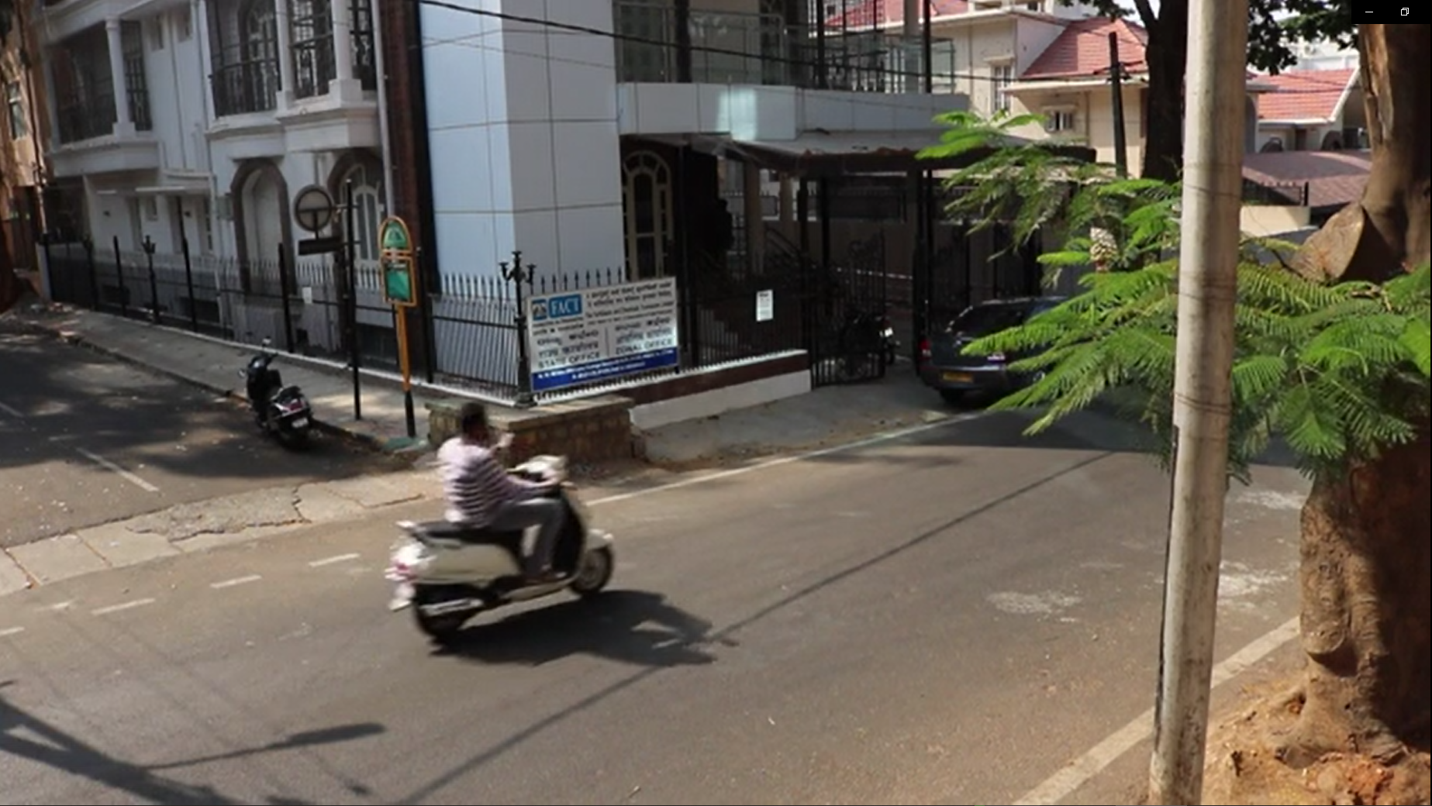
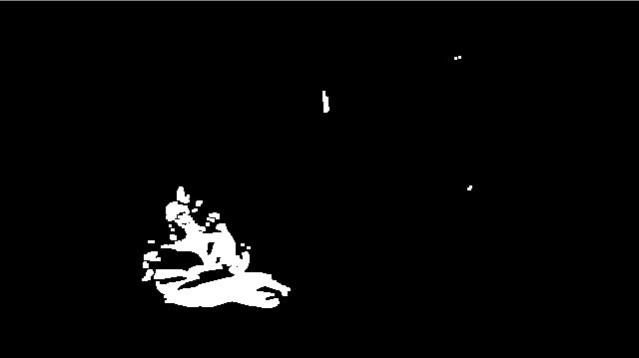
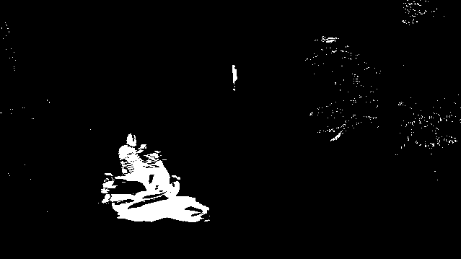


Motion detection and masking

Slide 25
Conclusion & Future Work
We have developed a novel method to generate compressed video summaries using current state-of-the-art algorithms (YOLO, Dynamic MOG).
We have successfully shown a proof of concept for a product with huge potential.
While the current implementation requires high-end processors to generate summaries, there is still a large scope for parallelisation
We plan to optimise and perform intensive testing to identify complicated semantic structures and properly deal with them.
We also plan on developing a GUI for our software.

Slide 26
Demonstration of the project

Slide 27
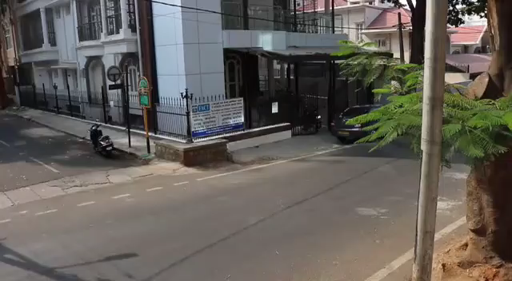
Example 1

Slide 28
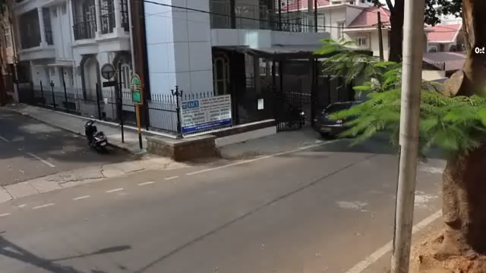
Summary

Slide 29

Query = bikes

Slide 30
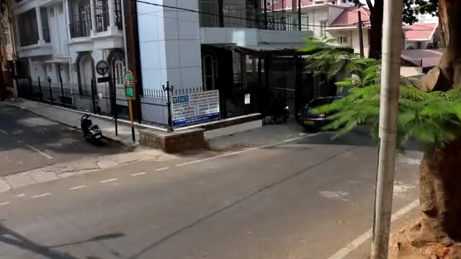
Query = cars

Slide 31
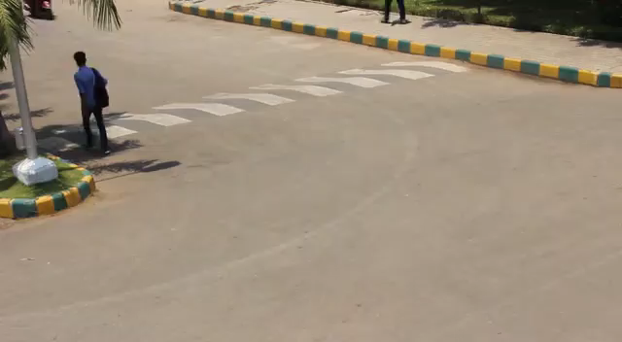
Example 2

Slide 32
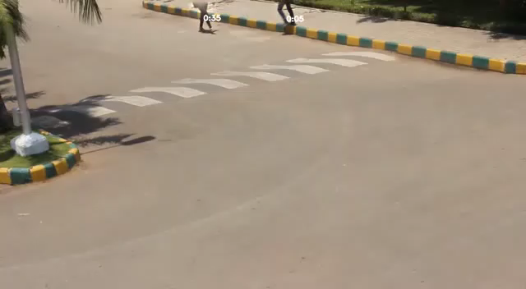
Example 2 – Summary

Slide 33
References
Redmon, Joseph, et al. "You only look once: Unified, real-time object detection." Proceedings of the IEEE conference on computer vision and pattern recognition. 2016.
Rodriguez, Mikel. "CRAM: Compact representation of actions in movies." 2010 IEEE Computer Society Conference on Computer Vision and Pattern Recognition. IEEE, 2010.
Zivkovic, Zoran, and Ferdinand Van Der Heijden. "Efficient adaptive density estimation per image pixel for the task of background subtraction." Pattern recognition letters 27.7 (2006): 773-780.
Pritch, Yael, et al. "Webcam synopsis: Peeking around the world." 2007 IEEE 11th International Conference on Computer Vision. IEEE, 2007.
Rav-Acha, Alex, Yael Pritch, and Shmuel Peleg. "Making a long video short: Dynamic video synopsis." 2006 IEEE Computer Society Conference on Computer Vision and Pattern Recognition (CVPR'06). Vol. 1. IEEE, 2006.
Pritch, Yael, Alex Rav-Acha, and Shmuel Peleg. "Nonchronological video synopsis and indexing." IEEE transactions on pattern analysis and machine intelligence30.11 (2008): 1971-1984.

